Slide 1
Appreciation of English and American Literature
Week 4 – Romeo and Juliet by William Shakespeare
Syllables and poetic metre

Slide 2
Pronunciation and Syllables
Understanding how the English Language Works

Slide 3
What is a syllable?
A syllable is a single unit of sound.
Syllables are the building blocks of words.

Slide 4
Rhyme and Syllables
Example of rhyming syllables:
Pig…

Slide 5
Rhyme and Syllables
Example of rhyming syllables:
Pig, Big, Dig, Fig, Gig, Wig
Tree……

Slide 6
Rhyme and Syllables
Example of rhyming syllables:
Pig, Big, Dig, Fig, Gig, Wig
Tree…… Knee, See, Bee, Be, Free, He, She, Completely, Utterly, Symbolically...

Slide 7
Rhyme and Syllables
Example of rhyming syllables:
Orange…

Slide 8
Rhyme and Syllables
Example of rhyming syllables:
Orange… singe, binge, hinge, syringe, fringe

Slide 9
Syllables, Stress and Timing
Chinese Mandarin and other varieties of Chinese are usually considered to be syllable-timed. The syllables have equal length (more or less).
English is a stress-timed language. The syllables have differing lengths, building different rhythms.
In English each word has one stress, and sentences have patterns of stress. This give English a particular intonation and musical ‘rise and fall.’

Slide 10
English and Syllables
How many syllables?
dog
lion
begin
computer
string
accident
activity
appropriately

Slide 11
When we stress a syllable…
1. It is longer… Eng-lish lang-uage
2. It’s a bit louder
3. It’s usually higher pitch (tone)
4. It is said more clearly
5. Your mouth moves more when you say it

Slide 12
English and Syllables
Which syllable is stressed?
dog
lion
begin
computer
string
accident
activity
appropriately

Slide 13
English and Syllables
Which syllable is stressed?
dog
lion
begin
computer
string
accident
activity
appropriately

Slide 14
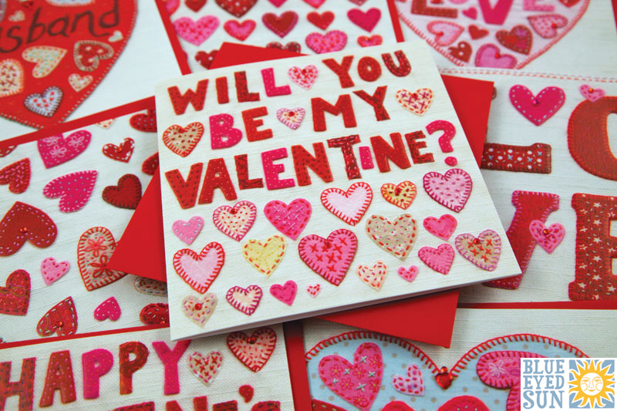

Slide 15
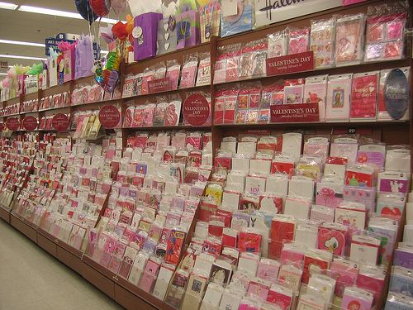
A British card shop before Valentine’s Day
Many of these cards will contain a couple of simple poetic lines.

Slide 16

Its origins are in Edmund Spenser’s The Fairy Queen (1590).
Almost all native English speakers know this poem – although not its origin.
“She bath'd with roses red, and violets blue, And all the sweetest flowres, that in the forrest grew.”

Slide 17
It is part of background English-language culture and is so famous it’s unusual for it to be used genuinely as a romantic poem anymore.
“She bath'd with roses red, and violets blue, And all the sweetest flowres, that in the forrest grew.”

Slide 18


Slide 19
Syllable and Rhyme Pattern
1, 2, 3, 4, 5, 6, 7, 8-Rhyme
1, 2, 3, 4, 5, 6, 7, 8-Rhyme

Slide 20
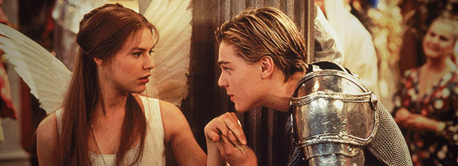
William Shakespeare – Romeo and Juliet
How many syllables?

Slide 21
Shakespeare – Romeo and Juliet
Two of the fairest stars in all the heaven,
Having some business, do entreat her eyes
To twinkle in their spheres till they return.
What if her eyes were there, they in her head?
The brightness of her cheek would shame those stars,
As daylight doth a lamp; her eyes in heaven
Would through the airy region stream so bright
That birds would sing and think it were not night.

Slide 22
Shakespeare’s ‘blank verse’
He usually wrote in ‘Iambic Pentameter’.
This means a small syllable sound (unstressed), followed by a large syllable sound (stressed) X 5.
Much poetry (verse) of this era uses Iambic pentameter. It is also found in other eras. This ‘blank verse’ typically doesn’t have rhymes at the end of each line.
The effect is a particular rhythm – perhaps a beauty, flow, and elegant sound, which adds to the meaning of the words.

Slide 23
Shakespeare – Romeo and Juliet
Two of the fairest stars in all the heaven,
Having some business, do entreat her eyes
To twinkle in their spheres till they return.
What if her eyes were there, they in her head?
The brightness of her cheek would shame those stars,
As daylight doth a lamp; her eyes in heaven
Would through the airy region stream so bright
That birds would sing and think it were not night.
There is one ‘rhyming couplet’ in this section.
Which two lines rhyme?

Slide 24
Shakespeare – Romeo and Juliet
Two of the fairest stars in all the heaven,
Having some business, do entreat her eyes
To twinkle in their spheres till they return.
What if her eyes were there, they in her head?
The brightness of her cheek would shame those stars,
As daylight doth a lamp; her eyes in heaven
Would through the airy region stream so bright
That birds would sing and think it were not night.
This section is mostly made of Iambs = unstress – stress
But there are several different stresses within it.
Which lines start with or contain a trochee?
Trochee = stress – unstress

Slide 25
Shakespeare – Romeo and Juliet
Two of the fairest stars in all the heaven,
Having some business, do entreat her eyes
To twinkle in their spheres till they return.
What if her eyes were there, they in her head?
The brightness of her cheek would shame those stars,
As daylight doth a lamp; her eyes in heaven
Would through the airy region stream so bright
That birds would sing and think it were not night.
This section is mostly made of Iambs = unstress – stress
But there are several different stresses within it.
Which lines start with or contain a trochee?
Trochee = stress – unstress

Slide 26
Shakespeare – Romeo and Juliet
Two of the fairest stars in all the heaven,
Having some business, do entreat her eyes
To twinkle in their spheres till they return.
What if her eyes were there, they in her head?
The brightness of her cheek would shame those stars,
As daylight doth a lamp; her eyes in heaven
Would through the airy region stream so bright
That birds would sing and think it were not night.
This section is mostly made of Iambs = unstress – stress
But there are several different stresses within it.
Which lines start with or contain a trochee?
Trochee = stress – unstress

Slide 27
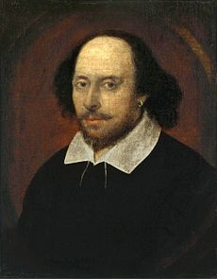
William Shakespeare (1564-1616)
Romeo and Juliet (1595)

Slide 28
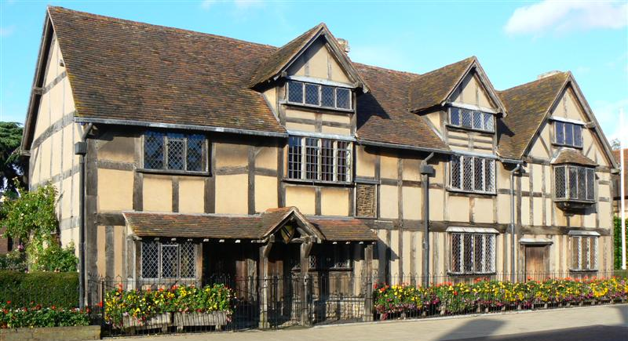
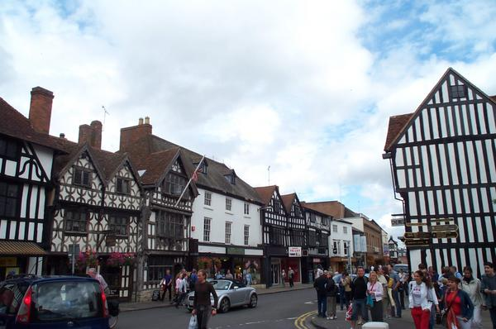
Shakespeare’s Life
He was born in Stratford Upon Avon in 1564

Slide 29
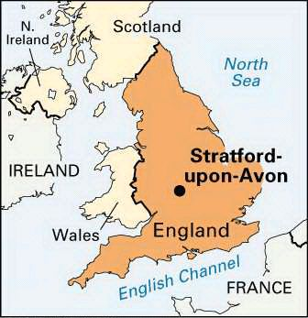
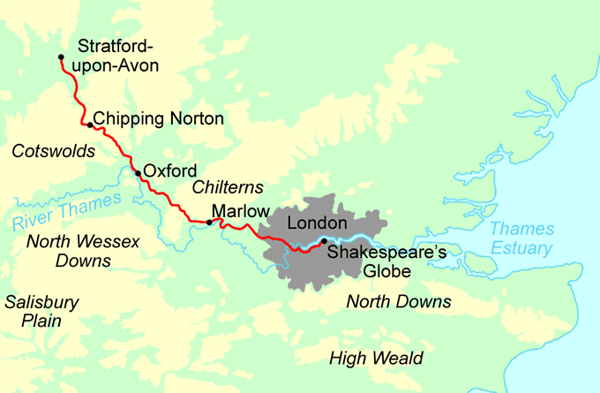
Stratford Upon Avon – 100 miles from London

Slide 30
Shakespeare’s Life
His father John Shakespeare was a glove maker. William went to school, but never to university.
When he was 18, he married Anne Hathaway who was 26.
He wrote during the reign of Elizabeth I, and along with the playwright Christopher Marlow (more highly regarded at the time) was a defining figure of the Elizabethan era.

Slide 31
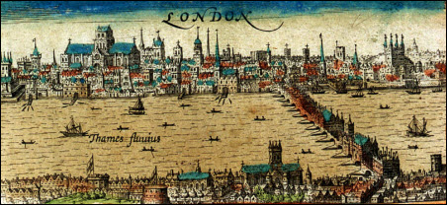
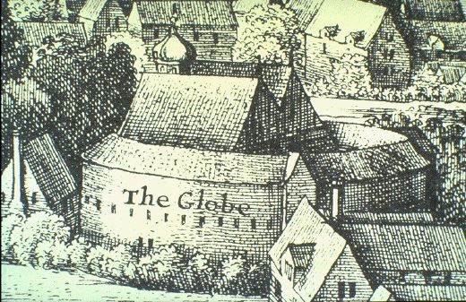
Shakespeare’s Life
No one’s sure how he got started as
an actor and writer, but by 1592 he
was living in London and well known.
In 1594 he was part of a Playing Company
called The Lord Chamberlain’s Men.
They performed at The Globe Theatre.

Slide 32
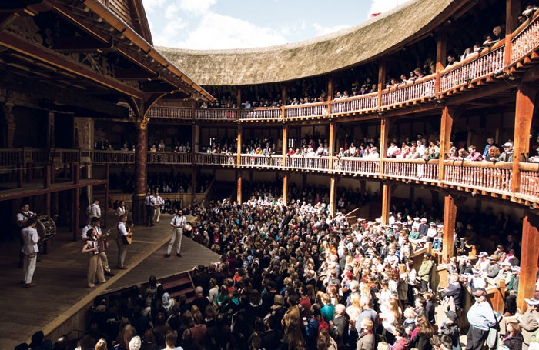
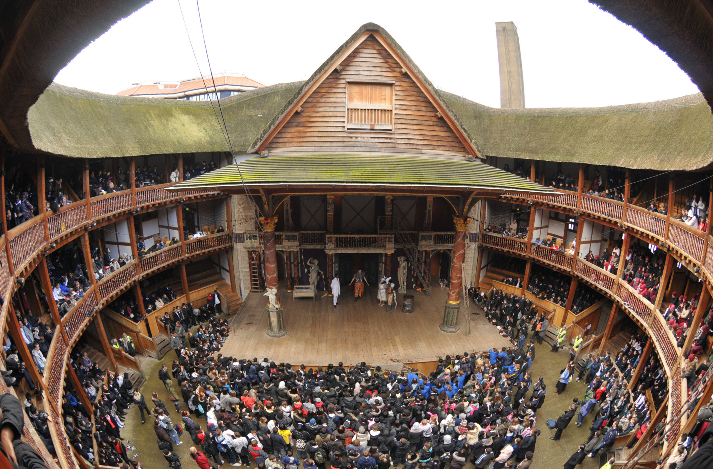
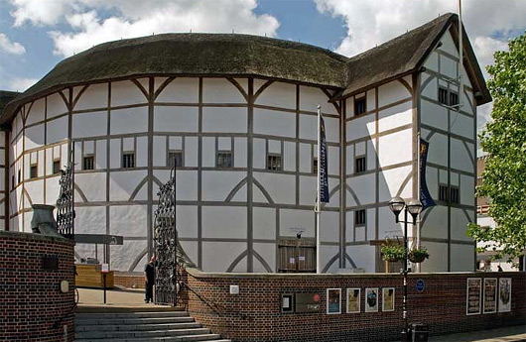
The Globe Theatre

Slide 33
Romeo and Juliet - History
Ovid 43 BC – 17 AD (Rome) wrote ‘Metamorphoses,’ which contained the story of Pyramus and Thisbe with some similar themes.
Masuccio Salernitano 1410 – 1475 (Salerno) wrote of Mariotta and Ganozza, with many of the key plot points.
Liugi da Porta 1485 – 1529 (Venice) adapted that story into Giuietta and Romeo, set in Verona.
Matteo Bandello 1480 – 1562 (Tortona) rewrote Giuietta and Romeo.
Pierre Boaistuau 1517 – 1576 (Nantes) translated it into French.

Slide 34
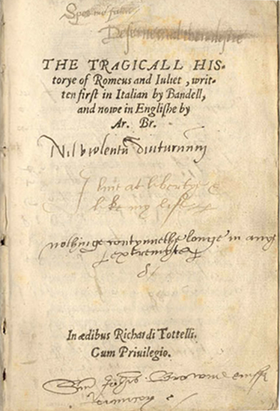
Romeo and Juliet - History
In 1562 Arthur Brooke wrote
The Tragicall Historye of Romeus and Juliet
It was popular in Elizabethan England to translate, or use as sources, plays, novellas and poems from Italy.

Slide 35
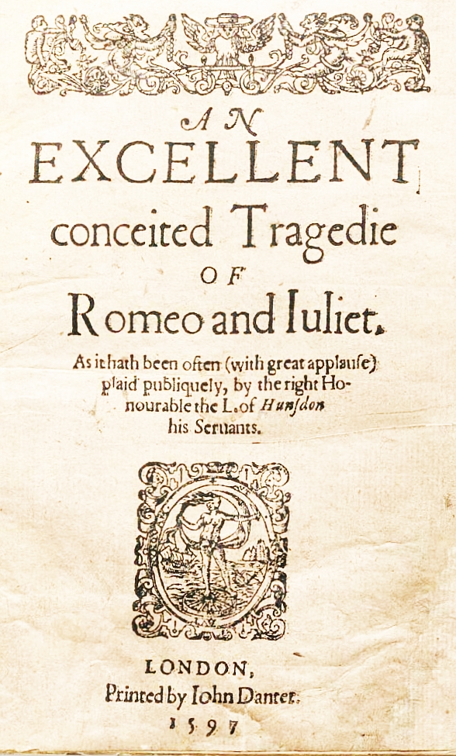
William Shakespeare’s Romeo and Juliet, 1595

Slide 36
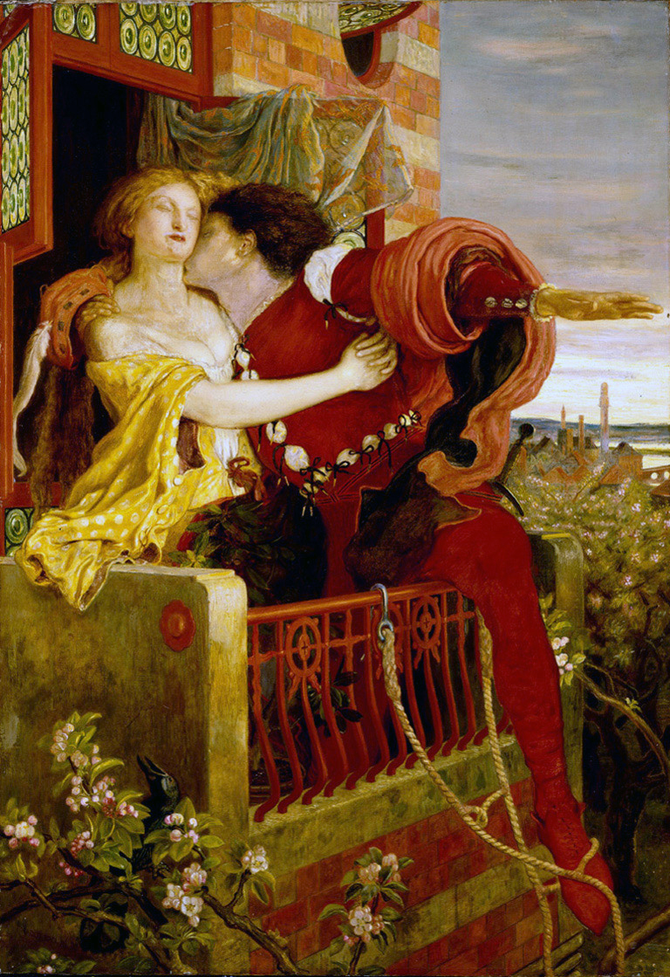
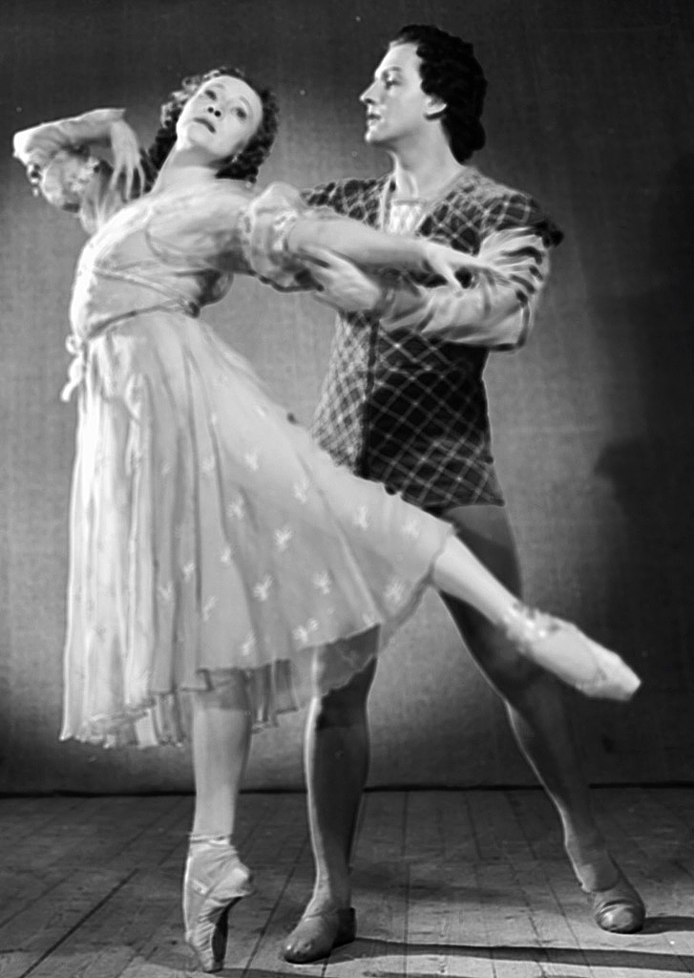
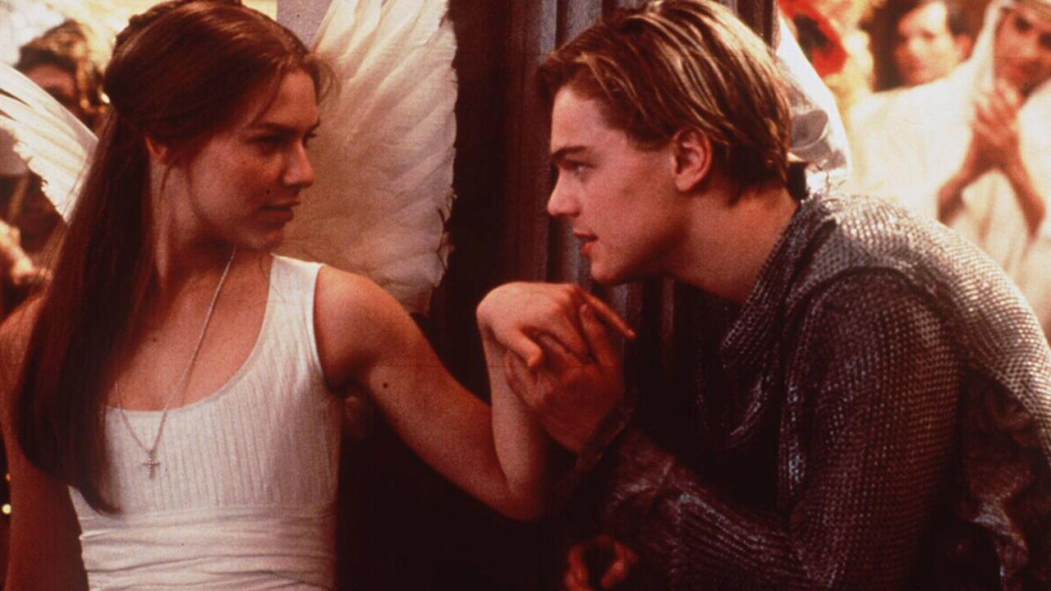
To what extent is Romeo and Juliet Shakespeare’s?
Baz Luhrman’s 1996 film version
Painting by Ford Madox Brown, 1867
Prokofiev’s 1935 ballet (1940 performance)

Slide 37
Romeo and Juliet – An Elizabethan Tragedy
The Montagues and the Capulets are two families with a feud, in an Italian city called Verona.
Romeo (Montague) and Juliet (Capulet) fall in love.
They secretly marry (helped by Juliet’s Nurse and Romeo’s priest.)
Yet, Juliet’s family plan her wedding to a Prince.
Romeo gets in a fight with Juliet’s cousin, Tybalt, and kills him. He is exiled.
The priest, Friar Laurence, makes a plan to fake Juliet’s death with a temporary poison, so that she and Romeo can then reunite and run away together.
But… news of the plan doesn’t reach Romeo, and he thinks she’s really died!
……

Slide 38
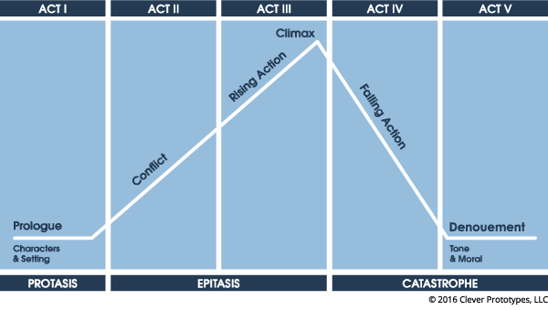
Romeo and Juliet – An Elizabethan Tragedy

Slide 39
Romeo and Juliet - Analysis
Act 1 – Scene 1
How do Romeo and Benvolio speak to each other?
What can we learn about their characters and the current situation?
How do they speak about love and women?

Slide 40
Romeo and Juliet - Analysis
Act 1 – Scene 5
Romeo and his Montague friends go to a party at the Capulet house.
How do Romeo and Juliet talk to each other?
What layered meanings are in their dialogue?
How does Shakespeare build tension in the scene?
There is a sonnet built from the dialogue – with rhyme pattern structured ABAB CDCD EFEF GG

Slide 41
Romeo and Juliet - Analysis
Act 2 – Scene 2
After the party at which they met, Romeo climbs into the Capulet family’s garden. He approaches the balcony, and thinks he sees something:
What can we learn about Romeo’s feelings for Juliet, and his views about love?

Slide 42
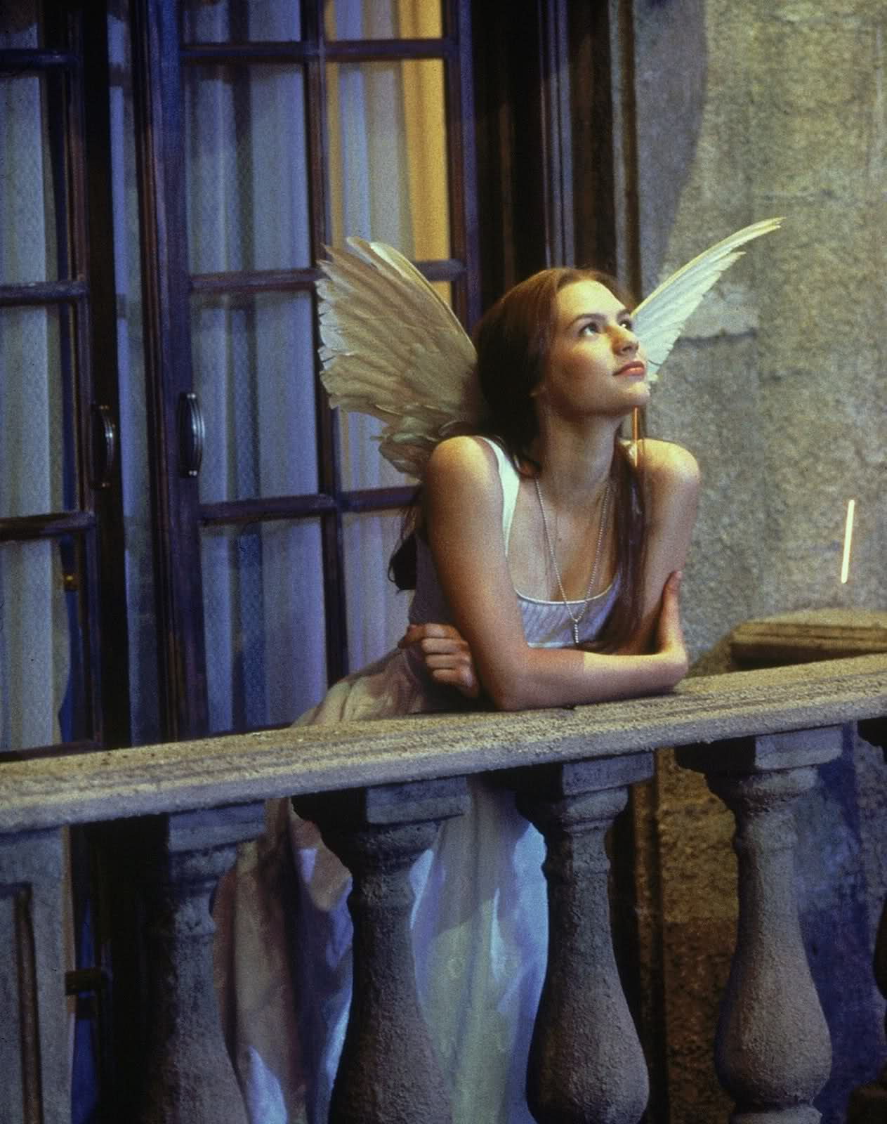
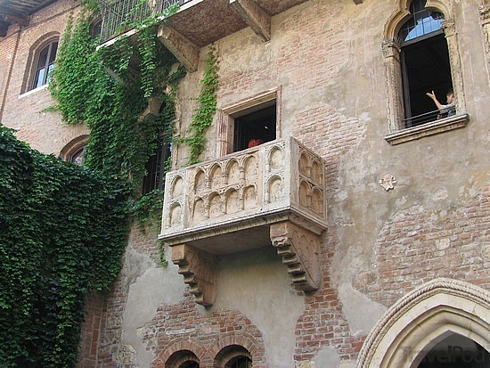
The balcony scene in Romeo and Juliet is one of Shakespeare’s most famous.
Verona, Italy – ‘Juliet’s Balcony’

Slide 43
Shakespeare – Romeo and Juliet, Balcony Scene
Romeo:
The brightness of her cheek would shame those stars,
As daylight doth a lamp; her eyes in heaven
Would through the airy region stream so bright
That birds would sing and think it were not night.
See, how she leans her cheek upon her hand!
O, that I were a glove upon that hand,
That I might touch that cheek!

Slide 44
Shakespeare – Romeo and Juliet, Balcony Scene
Juliet:
O Romeo, Romeo! wherefore art thou Romeo?
Deny thy father and refuse thy name;
Or, if thou wilt not, be but sworn my love,
And I’ll no longer be a Capulet.
Romeo
[Aside] Shall I hear more, or shall I speak at this?
……

Slide 45
Shakespeare – Romeo and Juliet, Balcony Scene
Juliet:
My ears have not yet drunk a hundred words
Of that tongue’s utterance, yet I know the sound:
Art thou not Romeo and a Montague?
Romeo
Neither, fair saint, if either thee dislike.

Slide 46
Shakespeare – Romeo and Juliet, Balcony Scene
Juliet
How camest thou hither, tell me, and wherefore?
The orchard walls are high and hard to climb,
And the place death, considering who thou art,
If any of my kinsmen find thee here.
Romeo
With love’s light wings did I o’er-perch these walls;
For stony limits cannot hold love out,
And what love can do that dares love attempt;
Therefore thy kinsmen are no let to me.

Slide 47
Overview
Do Romeo and Juliet love each other?
What do you think was Shakespeare’s view of love?
It is a tragedy because Romeo and Juliet die due to their warring families and their plan gone wrong. However, is it also a tragedy because they make the wrong choices and act with out-of-control emotion? If so, is that love?

Slide 48
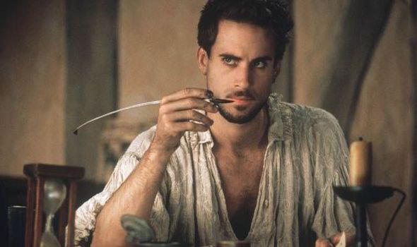
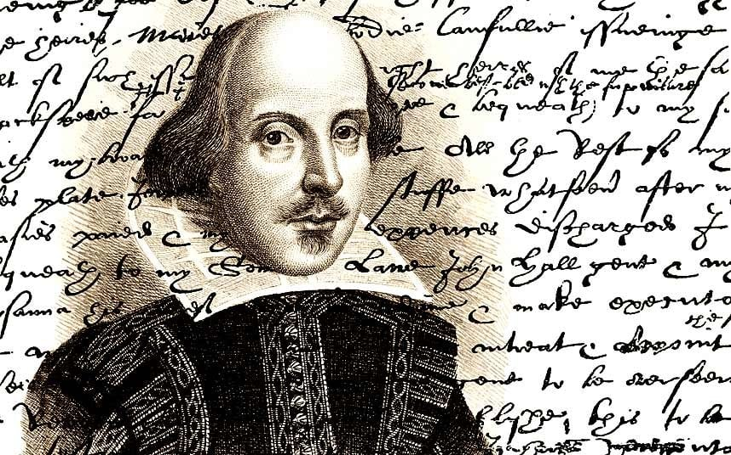
Can you write in Iambic Pentameter?
‘little syllable, Big Syllable,’ X 5 in one line
Write some sentences, simply saying what
you will do today… but in Shakespeare’s
famous syllable rhythm!

Slide 49
Homework
Please read the short excerpts from Robinson Crusoe.
Also read the article about ‘the novel’ as a form of literature.

